Slide 1
Chapter 2
Business Ethics and
Social Responsibility

Slide 2
What is Ethics?
Definition: normative standards, generally accepted rules of conduct that govern society
  What is “fair”?
  What if something “just doesn’t seem right”?
2-<number>
Notes:
Discuss seeing 2 movies for the price of one
Disclosing your salary cut after the loan application is submitted
Telling the clerk you received too much change

Slide 3
Ethics: Normative standards
Applying Standards of Moral Reasoning to Business Dilemmas
  Moral standard is established
  Individual moral standards differ
  Debate over sources of moral standards
2-<number>

Slide 4
Normative standards
There is no statute on cutting in line, but we do honor that normative standard
We refer to adultery as “cheating” because the normative standard is that such relationships breach the social norm
We refer to “cheating” on exams as well
2-<number>

Slide 5
What is Ethics?
Sources of Moral Standards
  Actual or positive law
  Natural law
  Moral relativism or situational ethics
  Religious beliefs
2-<number>

Slide 6
Ethical Dilemmas
Categories of Ethical Dilemmas
  Committing acts of personal decadence
  Perpetrating interpersonal abuse
  Permitting organizational abuse
  Violating rules
  Condoning unethical actions
  Balancing Ethical Dilemmas
2-<number>

Slide 7
Why We Fail to Reach Good Ethical Decisions
Rationalizations
  “Everybody else does it”
  “If we don’t do it, someone else will”
  “That’s the way it has always been done”
  “We’ll wait until the lawyers tell us it’s wrong”
2-<number>

Slide 8
Why We Fail to Reach Good Ethical Decisions
Rationalizations
  “It doesn’t really hurt anyone”
  “The system is unfair”
  “I was just following orders”
  “You think this is bad, you should have seen…”
  “It’s a gray area”
2-<number>

Slide 9
Resolution of Dilemmas
How would I view the problem if I sat on the other side of the fence?
Am I able to discuss my decision with my family, friends, and those closest to me?
How would I feel if this action was published on the front page of the newspaper?
2-<number>

Slide 10
Resolution of Dilemmas
STAKEHOLDER ANALYSIS
  Compliance: Are you violating any laws?
  Contribution: How does this action affect my customers, shareholders, creditors, employees, community, and suppliers?
2-<number>

Slide 11
Social Responsibility
Friedman view:
  Serve shareholders maximize profit
Social Responsbility School:
  Management is responsible first to shareholders but can also serve them by being responsible to larger society
  Business value is enhanced if it is responsive to society needs
2-<number>

Slide 12
Social Responsibility
The Social Responsibility School
  Manager should serve larger society
  Become involved in all types of political and social issues
  Encourage managers to be involved
2-<number>

Slide 13
Importance of Ethics
Ethics Resource Center Study
  Firms with written codes of ethics did substantially better as an investment than the general Dow Jones Composite over a 30-year period
  Executives feel ethical behavior strengthens a firm’s competitive edge
  Johnson & Johnson recall of Tylenol earned it high respect and higher earnings in spite of cost as well as a type of immunity to scrutiny for decades
2-<number>

Slide 14
Why Business Ethics?
Costs of Unethical Behavior
  BP and the refinery explosion and pipeline rupture and Deepwater Horizon
  Nestlé and the infant formula
  Beech-Nut and the fake apple juice
  GM, the Malibu design, and the litigation
  Union Carbide and Bhopal
2-<number>

Slide 15
Why Business Ethics?
Ethics as a Strategy
Impact on Reputation of Ethical Missteps
Reputation’s Impact on Market Price and Capitalization: Wells Fargo, Volkswagen
Reputational Capital and Its Importance
2-<number>

Slide 16
Ethics as a Strategy
The Subprime Mortgage Market
  Lucrative area
  Questions about fairness and disclosure
  With collapse of the mortgages, new regulations, economic setbacks, financial downturns in companies that pushed the envelope on subprime loans
  Companies that pulled back from subprimes performed better
2-<number>

Slide 17
Creating an Ethical Culture
The Tone at the Top
Sarbanes-Oxley Has Changed Corporate Governance, Reporting, and Operations
2-<number>

Slide 18
Creating an Ethical Culture
Sarbanes-Oxley and Culture
  Code of ethics
  Training for employees
  Means for anonymous reporting
  Following up on employee reports
  Reporting up the ladder
  Action by the board in monitoring and following up
  Self-reporting by company
  Enforcement within company
  High-ranking officer in charge
2-<number>

Slide 19
Creating an Ethical Culture
The Ethical Culture
Leadership
By
Example
Company Policies and
Compensation Systems
Reward Ethical and
Moral Behavior
Ethics Codes
Ethics Training: Annual/Scenarios
Investigations/Enforcement/Feedback
2-<number>

Slide 20
Creating an Ethical Culture
Developing an Ethics Stance
  Setting parameters for personal and business behavior
  Setting tone of tolerance or intolerance for behavior
2-<number>

Slide 21
Creating an Ethical Culture
Watch for Dangers of Unethical Environment
  Intense competition and issues of survival
  Managers making poor judgments
  Avoiding the “either/or conundrum”
  Disparity in time devoted to ethics discussion vs. performance discussion
2-<number>

Slide 22
Creating an Ethical Culture
Being Careful About Pressure and Signals
  Competition is so intense that business survival is threatened
  Managers make poor judgments
  Employees have few or no personal values
  Employees respond only to earnings demands
  Managers and executives are touting earnings
2-<number>

Slide 23
International Business
Businesses Must Decide Whether to Operate Under One Uniform Set of Standards
Cultures, Laws, and Standards Vary
  Creates issues of bribes, grease payments, and culture-related gifts
  Problems of economic development where bribery is common
2-<number>

Slide 24
Creating an Ethical Culture
A Possible Uniform Standard for Ethical Choices
  Categorical Imperative: How would you want to be treated?
  Are you comfortable with a world with your standards?
  Christian principle: The Golden Rule
  And as ye would that men should do to you, do ye also to them likewise. Luke 6:31
  Thou shalt love…they neighbor as thyself. Luke 10:27
  Confucius: What you do not want done to yourself, do not do to others.
  Aristotle: We should behave to our friends as we wish our friends to behave to us.
2-<number>

Slide 25
Creating an Ethical Culture
A Possible Uniform Standard for Ethical Choices
  Judaism: What you hate, do not do to anyone.
  Buddhism: Hurt not others with that which pains thyself.
  Islam: No one of you is a believer until he loves for his brother what he loves for himself.
  Hinduism: Do nothing to thy neighbor which though wouldst not have him do to thee.
  Sikhism: Treat others as you would be treated yourself.
  Plato: May I do to others as I would that they should no unto me.
2-<number>

Slide 26
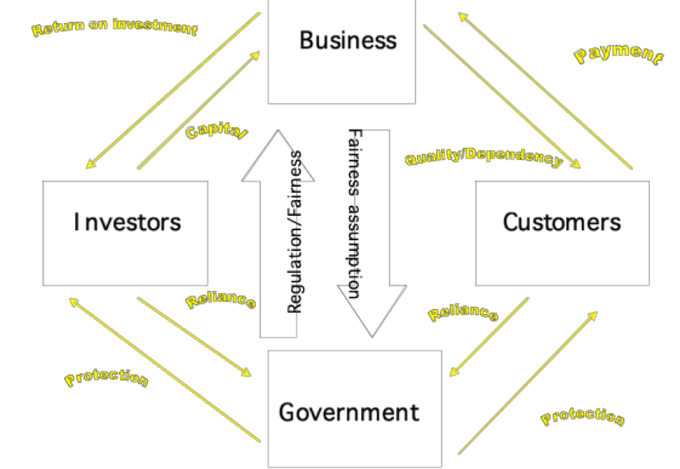
International Business
Interdependence of Trust, Business, and Government
2-<number>

